Slide 1

Introduction to Technical Analysis Fundamentals
SATISH NAGAR
DATA SCIENCE INTERN
AT HACKVEDA LTD.

Slide 2

Table of contents
Hook-Story
Introduction
Support &
Resistance level
Chart type 📊
Flow of
project

Slide 3
Table of contents
Application
Future Scope
Conclusion
References
Contact

Slide 4





Table of contents

Slide 5





Table of contents

Slide 6

HOOK – STORY
Imagine investing in the stock market and predicting price movements accurately.
Discover how support and resistance levels, trendlines, and chart patterns can help you master technical analysis.
Learn from HDFC Bank's historical data to make informed decisions.

Slide 7

Introduction
Technical Analysis?
Importance of Technical Analysis in stock trading.
key concepts: Support & Resistance, Trendlines, and Chart Patterns.

Slide 8
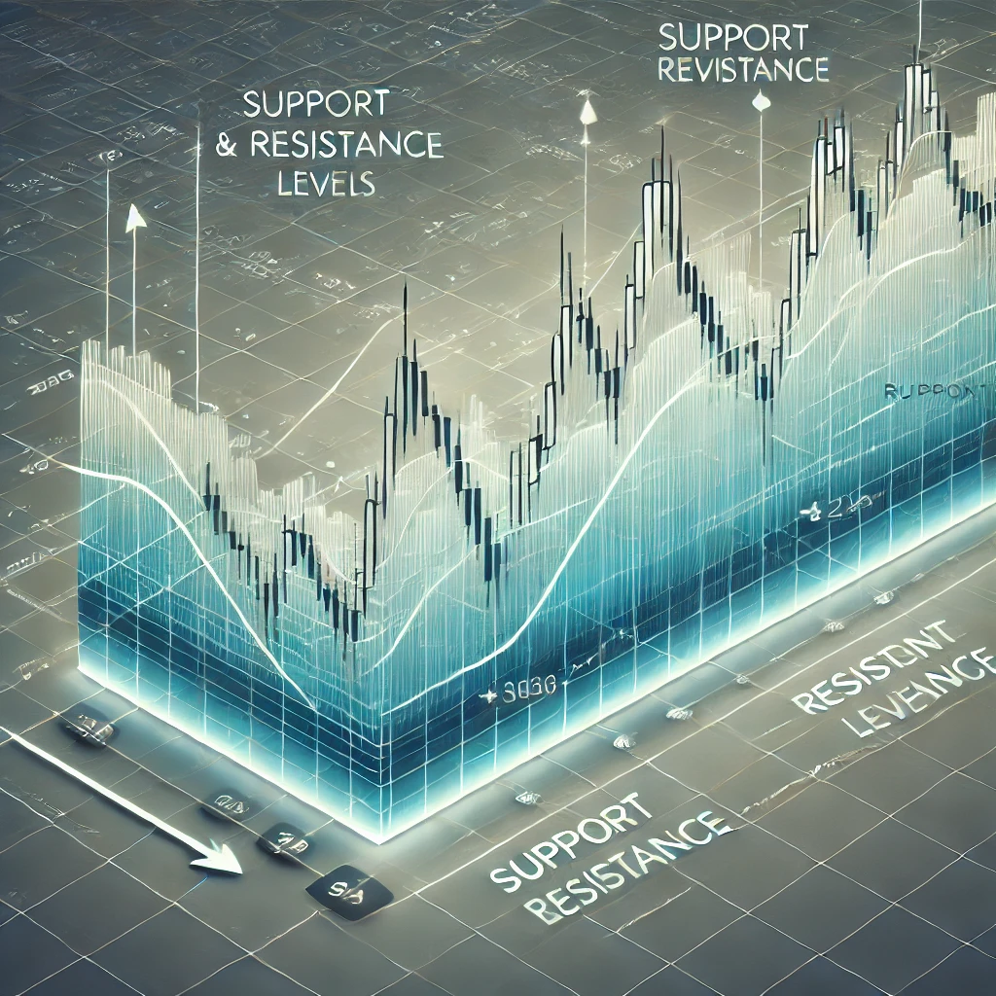
Support and Resistance Levels
Support: Price level where buying pressure prevents further decline.
Resistance: Price level where selling pressure prevents further rise.
Importance in understanding stock price movements.

Slide 9
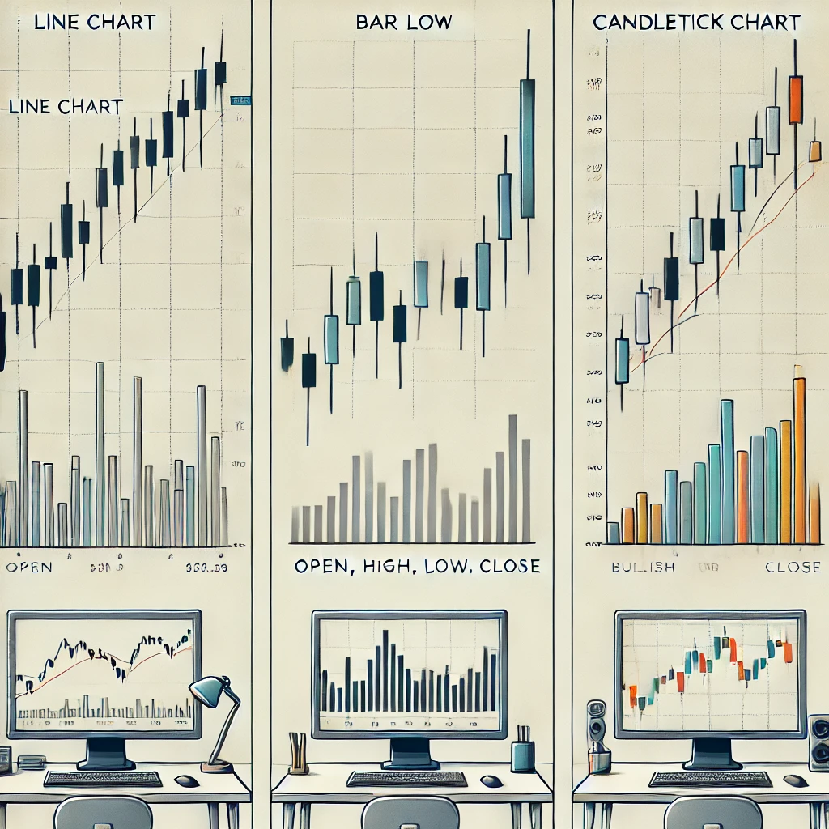

Chart Type
Types: Line Chart, Bar Chart,Trend line Candlestick Chart.
Each chart type provides unique insights.
Selection depends on the analysis goal.

Slide 10


Line Chart
A simple chart connecting closing prices to show overall trends.
Easy to read but lacks detailed data.
Advantages: Simple and easy to read.
Limitations: Lacks detailed information like open, high, and low prices.
Bar Chart
Displays open, high, low, and close prices with vertical bars.
Detailed but harder for beginners.
Advantages: Includes open, high, low, and close prices.
Limitations: Can be complex and hard to read for beginners.
Back

Slide 11
Trendline
A straight line connecting price points to show trends.
uptrends, downtrends.
Advantages: Highlights the direction of the trend.
Limitations: May give false signals during sideways markets.
Candlestick Chart
Shows open, high, low, and close prices in a visual format.
Advantages: Visual and detailed representation of price movements.
Limitations: Requires knowledge of patterns to interpret effectively.
Back

Slide 12






Flow of Project
Importing libraries
FOR MORE –Click HERE
Importing Data
FOR MORE –Click HERE
STEPS
DATA Preprocessing
FOR MORE –Click HERE
Required charts
FOR MORE –Click HERE

Slide 13
Step 1 : Importing Libraries
Import required libraries:
Pandas
Numpy
Matplotlib:
Seaborn
Back

Slide 14
Step 2 – Importing Data
Download the HDFCBANK CSV dataset
Use the pandas library in Python to read the CSV file into a dataframe
Back

Slide 15
Step 3 : Data Preprocessing
Clean and format the data
Includes steps such as:
Converting the 'Date' column to datetime format.
Setting the 'Date' column as the index. of Data Frame
Back

Slide 16
Step4 : Creating Trend Lines
The main objective of the project is to understanding of support and resistance levels, trendlines, and chart patterns. HDFC BANK DATASET.
Use the matplotlib library to plot the closing price of HDFCBANK over time.
Let’s Demonstrate
Back

Slide 17


Application (Technical Analysis Fundamentals)
Helps traders identify entry and exit points.
Predicts trend reversals and continuations.
Provides a systematic approach to market analysis.

Slide 18


Future Scope
Integration with AI for advanced predictions.
Enhanced visualization with modern tools.
Application in algorithmic trading.

Slide 19

Conclusion
Technical analysis simplifies stock market decisions.
Key tools: Support & Resistance, Trendlines, Chart Patterns.
Practical application leads to better market insights.

Slide 20
Reference
Data set : https://trello.com/1/cards/6438c561324b51d6acb221e1/attachments/645109ea1d9383a766147bd9/download/StockDataHDFCBANK.csv
Youtube:
https://www.youtube.com/watch?v=63eem-_a2uI&t=46s
3. ChatGpt

Slide 21



Contact
For any queries,
feel free to reach out at
satishnagar248@gmail.com
www.linkedin.com/in/satish-nagar-nilu

Slide 22
Thank-you☺

